Slide 1
CSE231 – Digital Logic Design
Multi-bit Adder Circuits,
Multiplier Circuit,
and
Magnitude Comparator Circuit

Slide 2
Implementations of Multi-bit Adders:
1. Ripple Carry Adder
2. Carry Lookahead Adder

Slide 3
Carry Lookahead Adder

Slide 4
Carry Lookahead Adder
Carry Propagate
1
1
1
1
1
1
0
1
0
0
1
1
1
0
0
X
+
0
0
0
1
1
0
1
0
1
0
Y
1
1
0
0
0
0
0
1
1
0
Carry End
Carry Generate

Slide 5
Carry Lookahead Adder
Carry Generate
  G_{i} = X_{i} . Y_{i}
  Always generates a carry if G_{i} evaluates to true.
Carry Propagate
  P_{i} = X_{i} xor Y_{i}
  Propagates a carry if P_{i} evaluates to true AND there is a carry-in into the adder stage.
    Carry-in into the first adder stage.
    Carry-out generated in the previous adder stage.

Slide 6
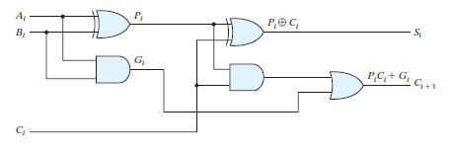
The Full Adder in terms of P_{i} and G_{i}
P_{i} = A_{i} xor B_{i}
S_{i} = A_{i} xor B_{i} xor C_{i}
G_{i} = A_{i}.B_{i}
C_{i+1} = A_{i}.B_{i} + A_{i}.C_{i} + B_{i}.C_{i}

Slide 7
Carry Lookahead Adder
The Carry Generate (G_{i}) and Carry Propagate (P_{i}) can be created directly from the inputs.
no ripple delay
only 1 gate delay

Slide 8
Carry Lookahead Adder
C_{out,i} is a function of G_{i} and P_{i}
C_{out,i} = (X_{i}.Y_{i}) + ( (X_{i} + Y_{i}).(C_{in,i}) )
  This is the Cout of the Full Adder
C_{out,i} = (G_{i}) + ( (P_{i}).(C_{in,i}) )
  where C_{in,i} = C_{out,i-1}

Slide 9
Carry Lookahead Adder
For the LSB,
  C_{out,0} = (G₀) + ( (P₀).(C_{in,0}) )
  no ripple delay

Slide 10
Carry Lookahead Adder
For LSB+1:
  C_{out,1} = (G₁) + ( (P₁) . C_{in,1} )
  C_{out,1} = (G₁) + ( (P₁) . C_{out,0} )
  C_{out,1} = (G₁) + ( (P₁) . (G₀ + P₀.C_{in,0}) )
  C_{out,1} = G₁ + P₁.G₀ + P₁.P₀.C_{in,0}
    All G and P terms derived directly from associated inputs
    No ripple delay

Slide 11
Carry Lookahead Adder
For LSB+2:
  C_{out,2} = (G₂) + ( (P₂) . C_{in,2} )
  C_{out,2} = (G₂) + ( (P₂) . C_{out,1} )
  C_{out,2} = (G₂) + ( (P₂) . (G₁ + P₁.C_{in,1}) )
  C_{out,2} = (G₂) + ( (P₂) . (G₁ + P₁.C_{out,0}) )
  C_{out,2} = G₂ + P₂.G₁ + P₂.P₁.C_{out,0}
Similar for LSB+3, LSB+4, etc.
Must be expanded
in terms of G₀, P₀,
and C_{in,0}

Slide 12
Carry Lookahead Adder
Sum: S_{i} is a function of X_{i}, Y_{i}, and C_{in,i}
  S_{i} = X_{i} xor Y_{i} xor C_{in,i}
  S_{i} = X_{i} xor Y_{i} xor C_{out,i-1}
Carry: C_{out,i} derived from G_{i} and P_{i}
  G_{i} and P_{i} are functions of the inputs
Carries do not ripple from one stage to the next
  Delay ~ log₂(n)
  Area required ~ (n)*(log₂(n))
    Greater than area required for RCA

Slide 13
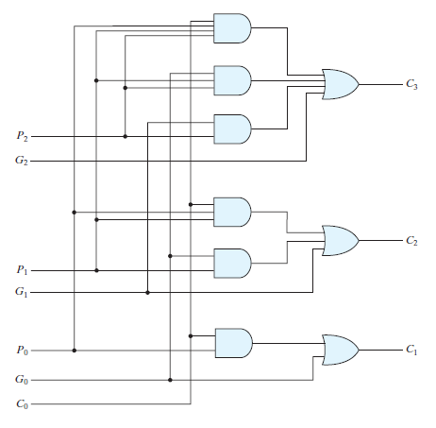
Carry Lookahead Adder

Slide 14
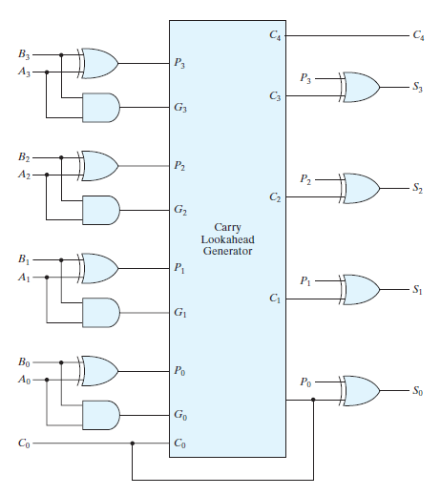
Carry Lookahead Adder

Slide 15
Carry Lookahead Adder
74LS283: 4-bit Binary Adder with Fast Carry

Slide 16
Adder/Subtractor using 2's Complement

Slide 17
Adder / Subtractor using Two’s Complement
Could build separate binary adder and subtractor
  Not common
Use Two’s Complement integer representation
  Addition uses binary adder
  Subtraction uses binary adder with the Two’s Complement representation for the subtrahend
Issues
  Cannot directly convert the most negative n-bit binary number to its (positive) magnitude in Two’s Complement representation
  Must detect overflow

Slide 18
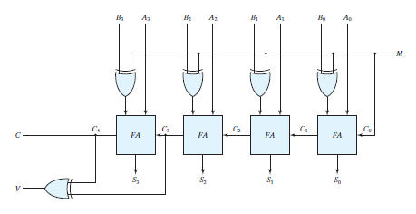
Adder / Subtractor

Slide 19
Detecting Overflow
Compare sign of operands with sign of result
  Overflow occurs if operands have same sign and result has different sign
    Addition of two positive #s results in negative #
    Addition of two negative #s results in positive #
Logic function(s) for overflow (for 4-bit Adder)
  Overflow = X₃.Y₃.S₃' + X₃'.Y₃'.S₃
  Overflow = C₃ xor C₄ = C₃'.C₄ + C₃.C₄'

Slide 20
Multiplier Circuit

Slide 21
Multiplier Circuit
Multiplication requires two basic operations:
  Addition
  Logical Shift
A binary multiplier circuit can be designed hierarchically using
  Full Adders
  AND gates

Slide 22
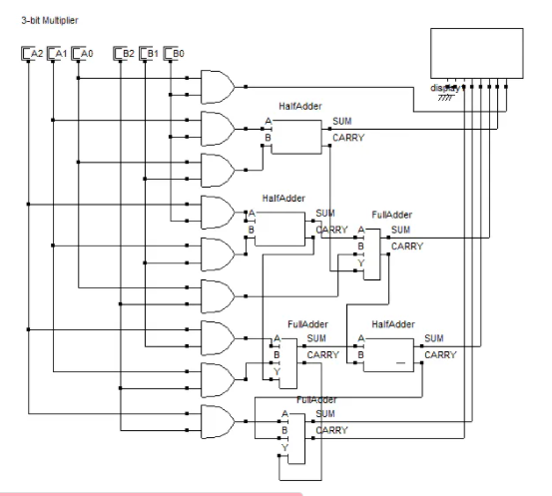

Slide 23
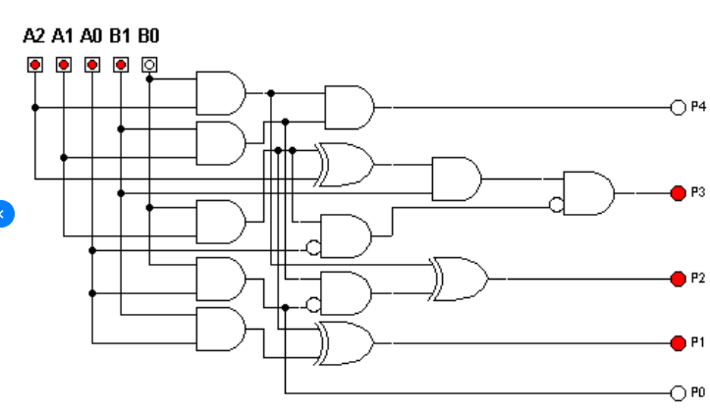

Slide 24
Binary Multiplication
Multiplicand M
(11)
1 1 1 0
4 bits
Multiplier Q
(14)
×
1 0 1 1
4 bits
Partial product 0
1 1 1 0
+
1 1 1 0
Partial product 1
1 0 1 0 1
+
0 0 0 0
Partial product 2
0 1 0 1 0
+
1 1 1 0
Product P
(154)
1 0 0 1 1 0 1 0
8 bits
# of bits in P = # of bits in M + # of bits in Q

Slide 25
Binary Multiplication
M (Multiplicand) = m₃m₂m₁m₀
Q (Multiplier) = q₃q₂q₁q₀
PP0 = m₃.q₀ m₂.q₀ m₁.q₀ m₀.q₀
partial
product
0 pp0₃ pp0₂ pp0₁ pp0₀
+ m₃.q₁ m₂.q₁ m₁.q₁ m₀.q₁ 0
PP1 = pp1₄ pp1₃ pp1₂ pp1₁ pp1₀

Slide 26
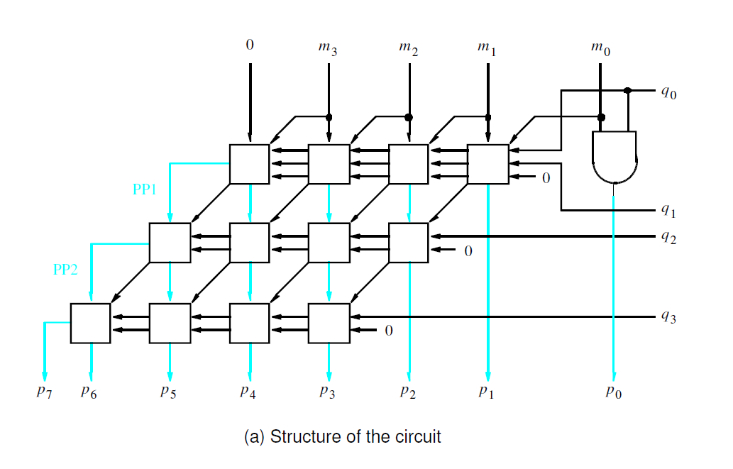
Multiplier Circuit
PP1
PP2

Slide 27
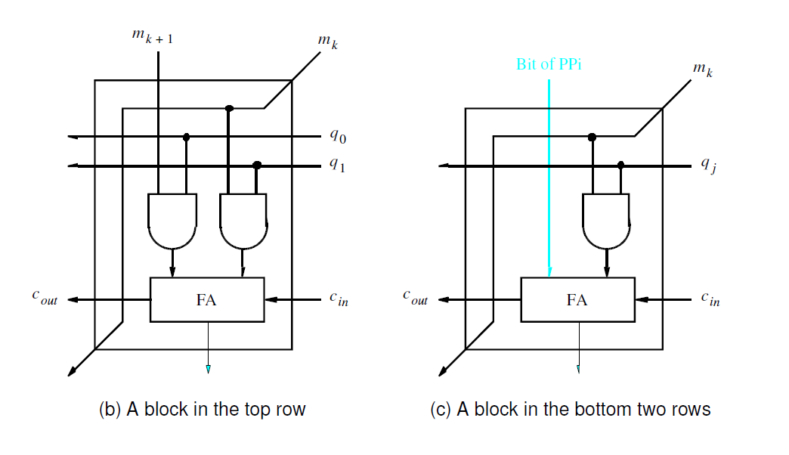
Multiplier Circuit
Bit of PPi

Slide 28
Magnitude Comparator

Slide 29
Magnitude Comparator
How many rows are there in the Truth Table for an n-bit magnitude comparator?
For a 2-bit magnitude comparator
  4 inputs, 16 rows
For a 3-bit magnitude comparator
  6 inputs, 64 rows
For an n-bit magnitude comparator
  2n inputs, 2^{2n} rows

Slide 30
Magnitude Comparator
Designing a magnitude comparator using a Truth Table is too cumbersome.
The magnitude comparator has a certain amount of regularity.
Take advantage of the regularity.
Design the circuit using an algorithm.

Slide 31












Magnitude Comparator
A = a₃a₂a₁a₀ B = b₃b₂b₁b₀
X_{i} = a_{i}.b_{i} + a_{i}'.b_{i}' = a_{i} xnor b_{i} (equivalence)
(A = B): X₃.X₂.X₁.X₀

Slide 32









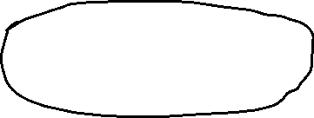




Magnitude Comparator
A = a₃a₂a₁a₀ B = b₃b₂b₁b₀
X_{i} = a_{i}.b_{i} + a_{i}'.b_{i}' = a_{i} xnor b_{i} (equivalence)
(A = B): X₃.X₂.X₁.X₀
(A > B): a₃b₃' + X₃a₂b₂' + X₃X₂a₁b₁' + X₃X₂X₁a₀b₀'

Slide 33
















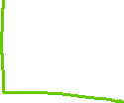



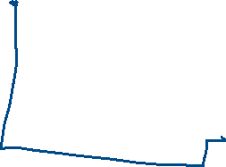

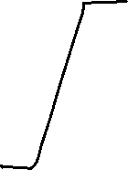



















Slide 34
Magnitude Comparator
A = a₃a₂a₁a₀ B = b₃b₂b₁b₀
X_{i} = a_{i}.b_{i} + a_{i}'.b_{i}' = a_{i} xnor b_{i} (equivalence)
(A = B): X₃.X₂.X₁.X₀
(A > B): a₃b₃' + X₃a₂b₂' + X₃X₂a₁b₁' + X₃X₂X₁a₀b₀'
(A < B): a₃'b₃ + X₃a₂'b₂ + X₃X₂a₁'b₁ + X₃X₂X₁a₀'b₀

Slide 35
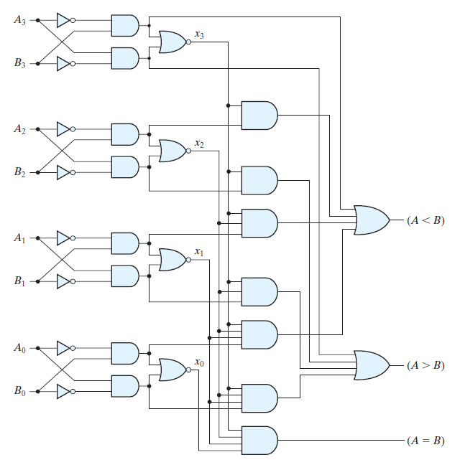
Magnitude Comparator

